Slide 1


Analysis of Customer Base and Sales Performance
Sophia Velicer

Slide 2
Overview
To optimize sales performance of Turtle Games, the team has started by addressing the following topics:
Loyalty point system
Understanding customer demographic
Marketing based on customer reviews
Sales per product
Data reliability
Prediction of global sales

Slide 3
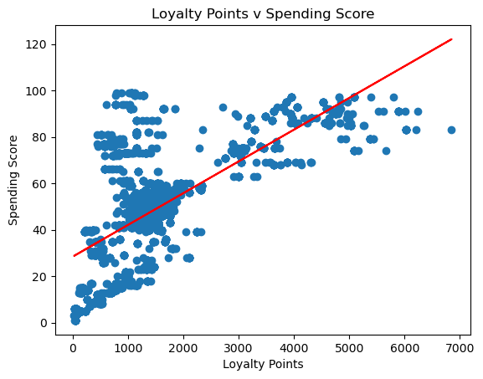
Loyalty Point Accumulation
Incentivise customers and understand customer behaviour
Spending score is the best indicator, though inaccurate
No definitive factor
Large multicollinearity between variables
Further data
Recency of purchase
Purchasing history

Slide 4
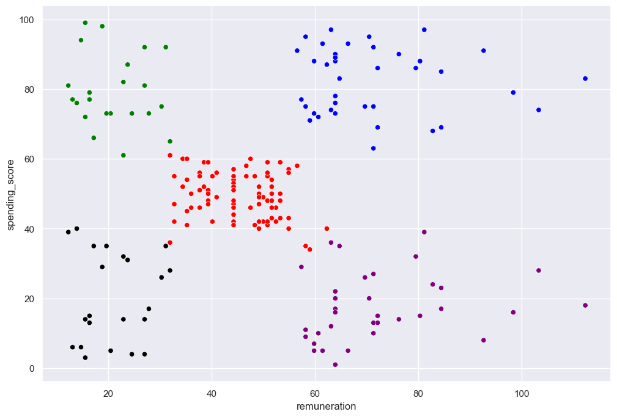
Customer Demographic Analysis
Five distinct clusters
Those who make the most and the least also spend the most and the least.
Largest group in the middle
Further customer survey

Slide 5
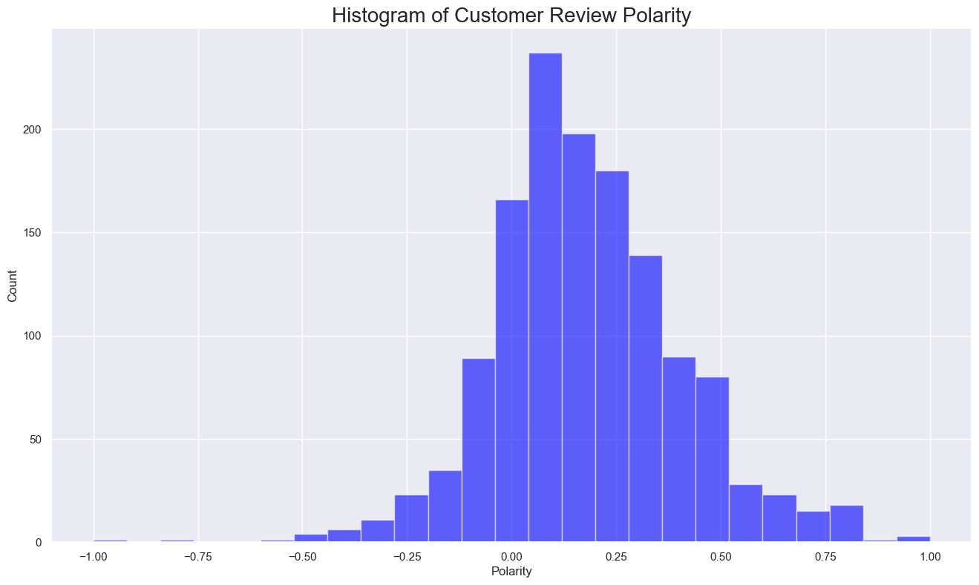
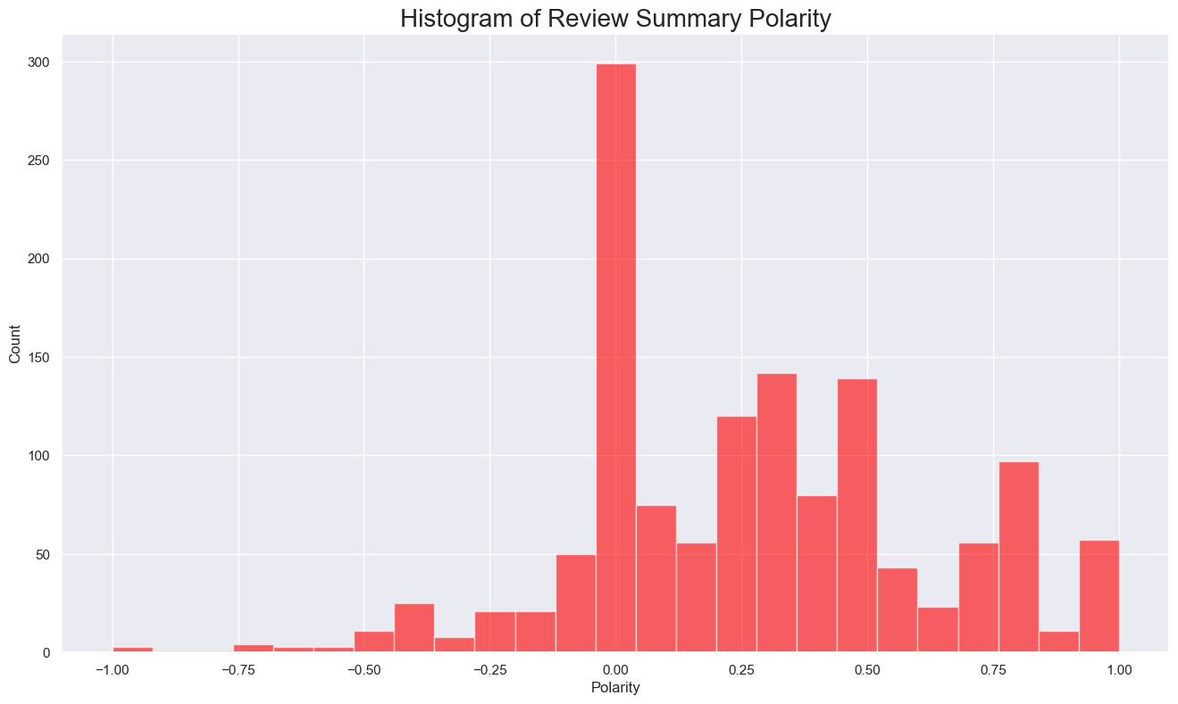
Customer Opinion

Slide 6
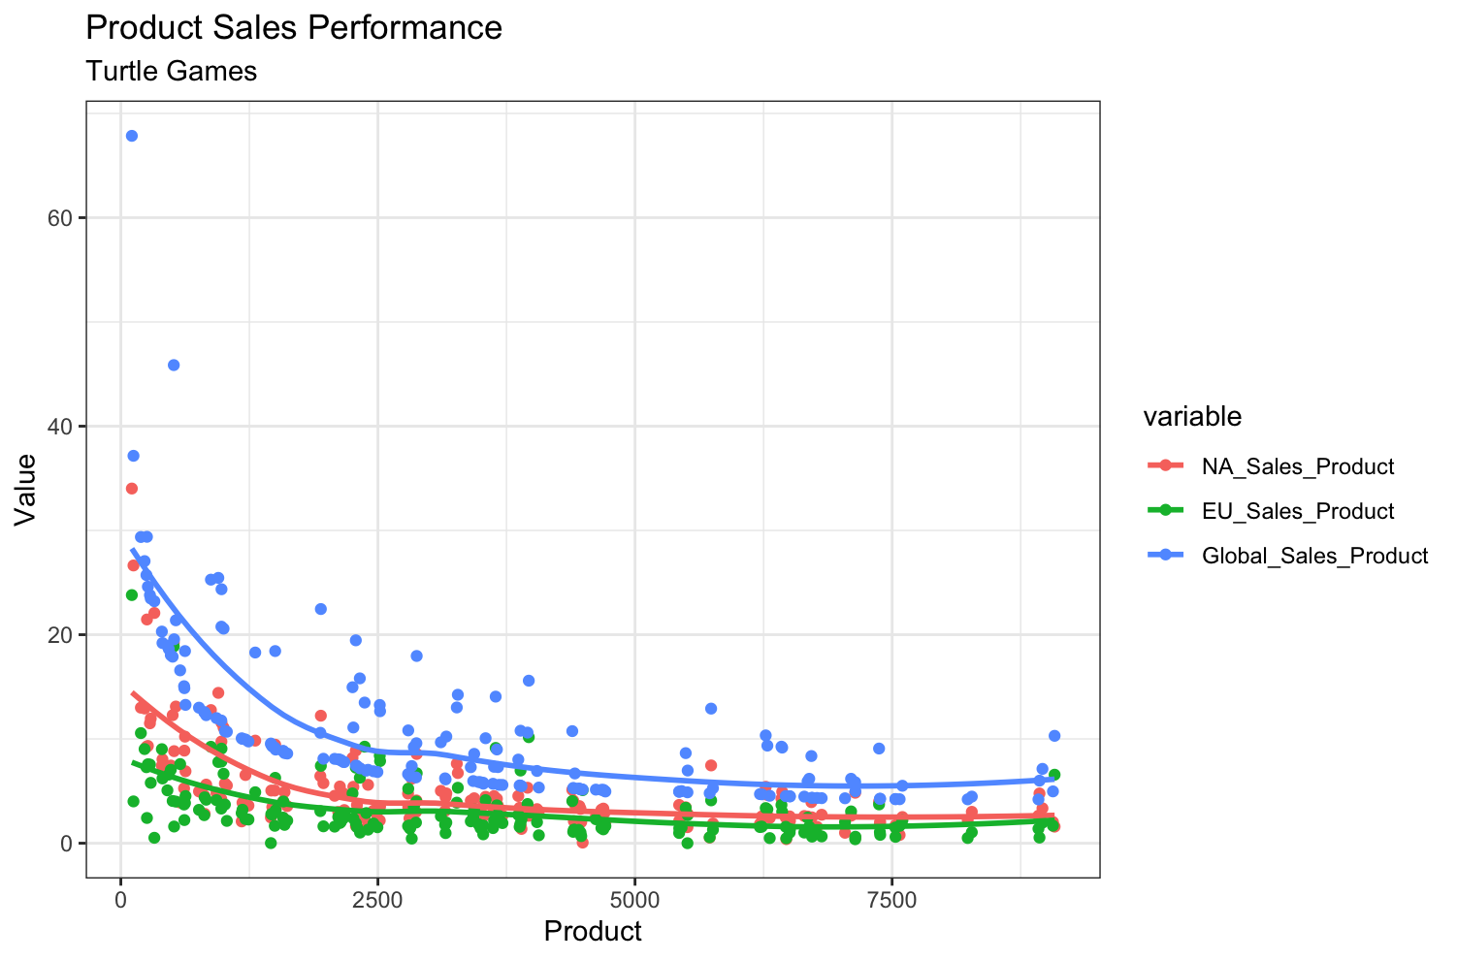
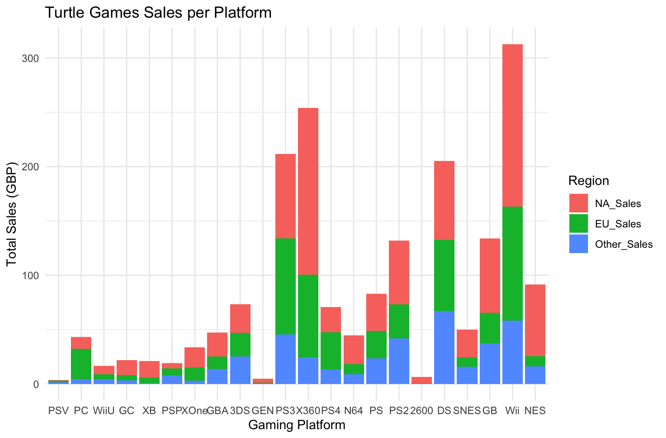
Platform & Product Sales Performance

Slide 7
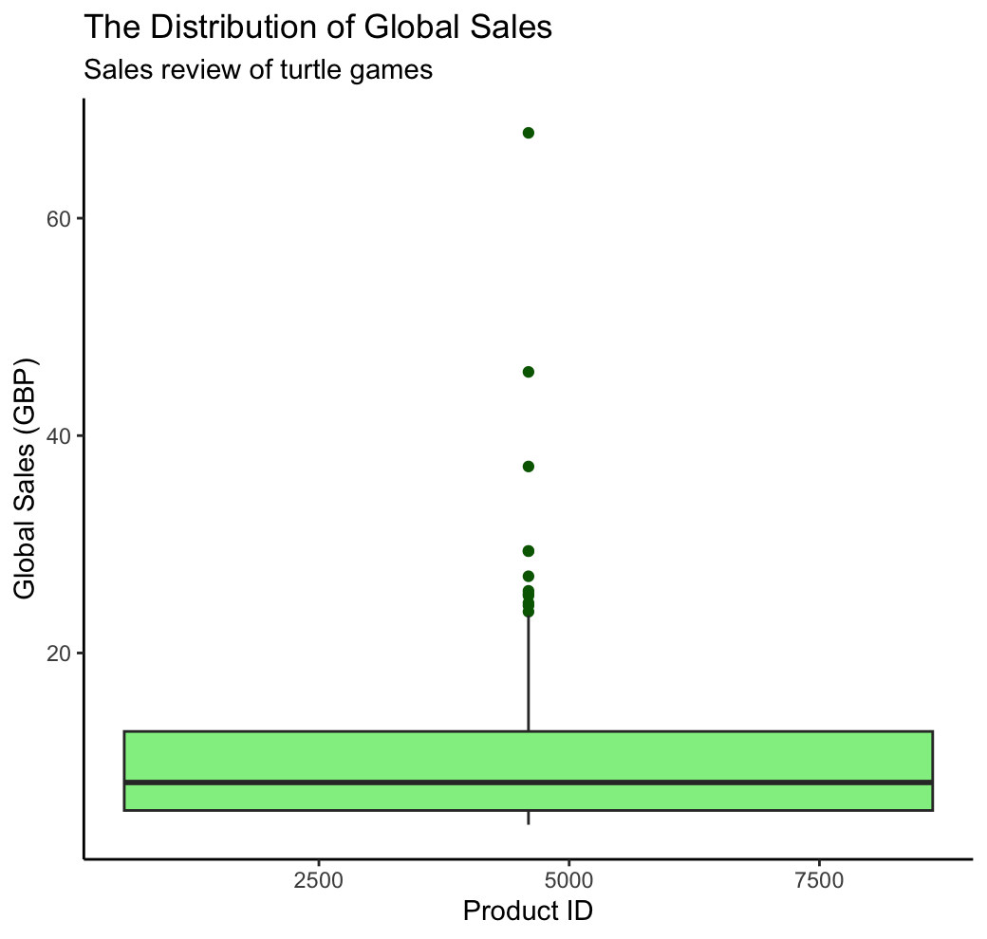
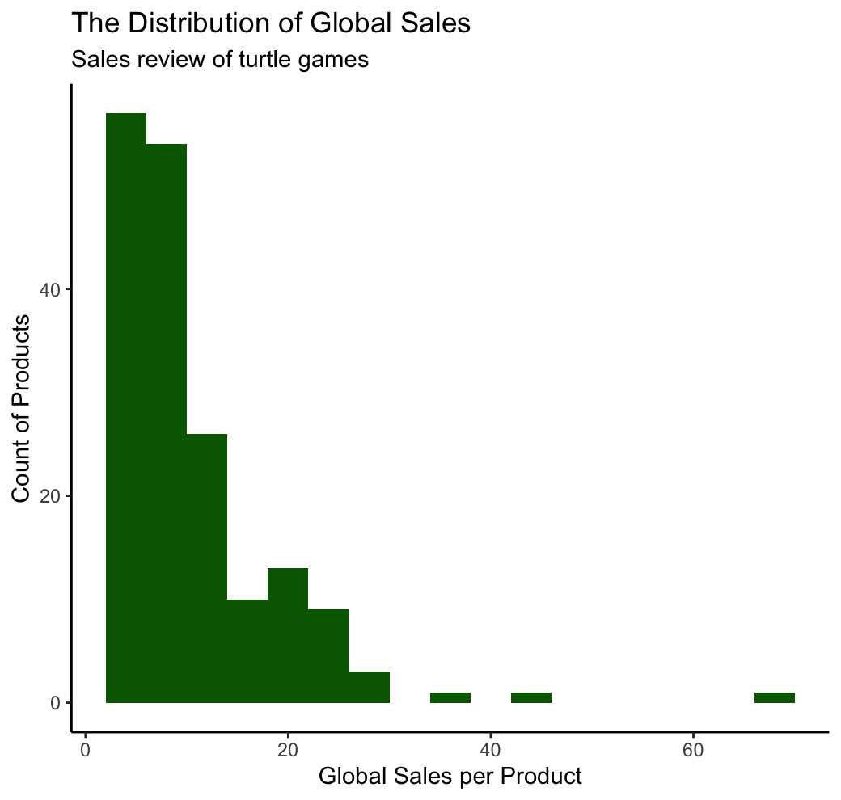
Data Quality

Slide 8
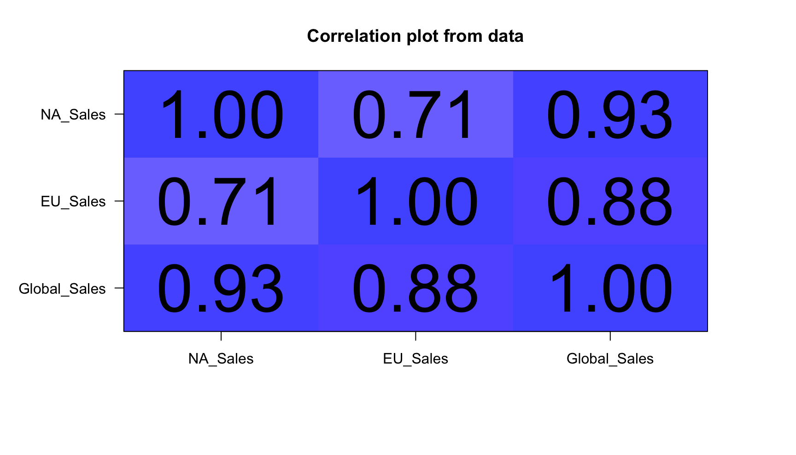
Prediction
Large correlation between the regions
North America is the biggest indicator
Prediction model has an adjusted R-squared value of 0.96.

Slide 9
Recommendations
More data to determine loyalty points
Customer survey
Further analysis of customer reviews.
Focus on popular platforms (Wii, X360, PS3, DS)
Beta test games in the North American market to predict global sales.

